Slide 1
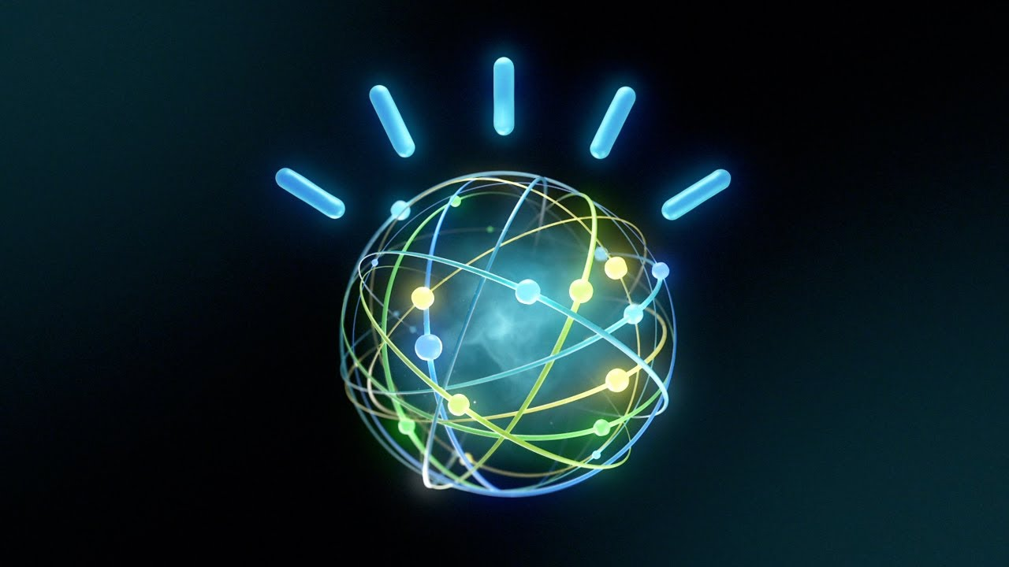
IBM’s Watson
Rohan Nyati
R177219148
500075940
Batch-5

Slide 2
REFERENCES
• Kelly III, J. E., & Hamm, S. (2013). Smart machines: IBM's Watson and the era of cognitive computing. Columbia University Press.
• Ferrucci, D. A. (2012). Introduction to “this is watson”. IBM Journal of Research and Development, 56(3.4), 1-1.
• Lally, A., Prager, J. M., McCord, M. C., Boguraev, B. K., Patwardhan, S., Fan, J., ... & Chu-Carroll, J. (2012). Question analysis: How Watson reads a clue. IBM Journal of Research and Development, 56(3.4), 2-1.

Slide 3
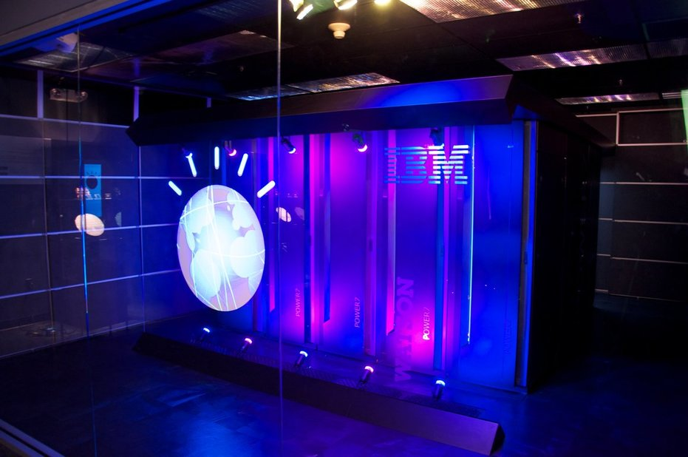
Introduction
Super Computer developed by IBM Research
Named for IMB’s founder: Thomas J. Watson
Initially created for Jeopardy! Game Show
Dr. David Ferrucci leads the Watson project

Slide 4

DATA COLLECTION TECHNIQUES
• Question-answering
• Deep understanding of natural language.
– Process and answer complex questions
that have puns, irony, and/or riddles
• Runs on cluster of Power of 750 computers

Slide 5
Purpose of Watson
• Idea formed during IBM top executives brainstorming publicity stunts
• Deep Blue– chess supercomputer defeated Garry Kasparov
• IBM’s previous most advanced machine was slow and inaccurate
• IBM believes that Watson can predict the future within the next 10 years.

Slide 6
CONCLUSION
• Watson is getting ready to deal with cyber criminals as it is being fed with large reports and data all aiming at identifying threats and outliers.
• There is also a WatsonPaths which shows how Watson arrived at a particular conclusion in an assessment.
• Overall goal: “to create a new generation of technology
that can find answers from data more effectively than
current search engines”

